Slide 1
OGC ISG Sprint Kickoff Presentation: Helyx
Dr Anneley Hadland (Primary POC)
Dan Bala (Secondary POC)
September 1, 2020

Slide 2
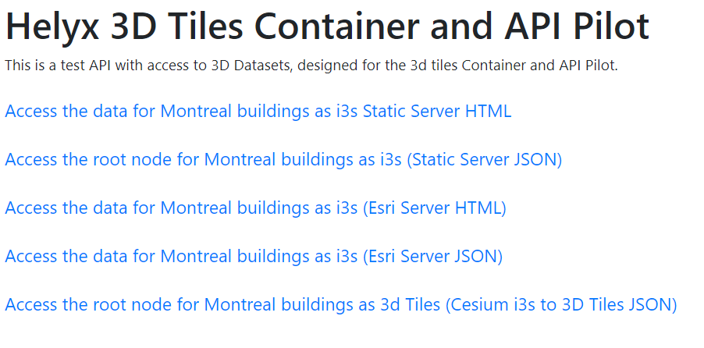
Approach: Challenge 2
What is an alternate resource:
Does a resource have to be exactly the same size and scale, but just be an alternate delivery mechanism (e.g. 3D tiles as opposed to i3s) to be an alternate resource?
What if the name or the version of the resource changes?
What if a query took a subset into a federated server – is this an alternate resource?
What about if a resources is changed on the fly using a convertor service?
Relevant parts of previous reports:
D001 3D Data Container ER (aka Pilot Implementation Experiences): https://portal.ogc.org/files/?artifact_id=94028.
Section 7.1 Alternate APIs (2d representation), 7.3 resource architecture, 7.5 data architecture
D002 OGC API - GeoVolumes ER (aka Draft Specification): https://portal.ogc.org/files/?artifact_id=94029:
Section 14.1.4 Collections
Chapter 15 media types

Slide 3
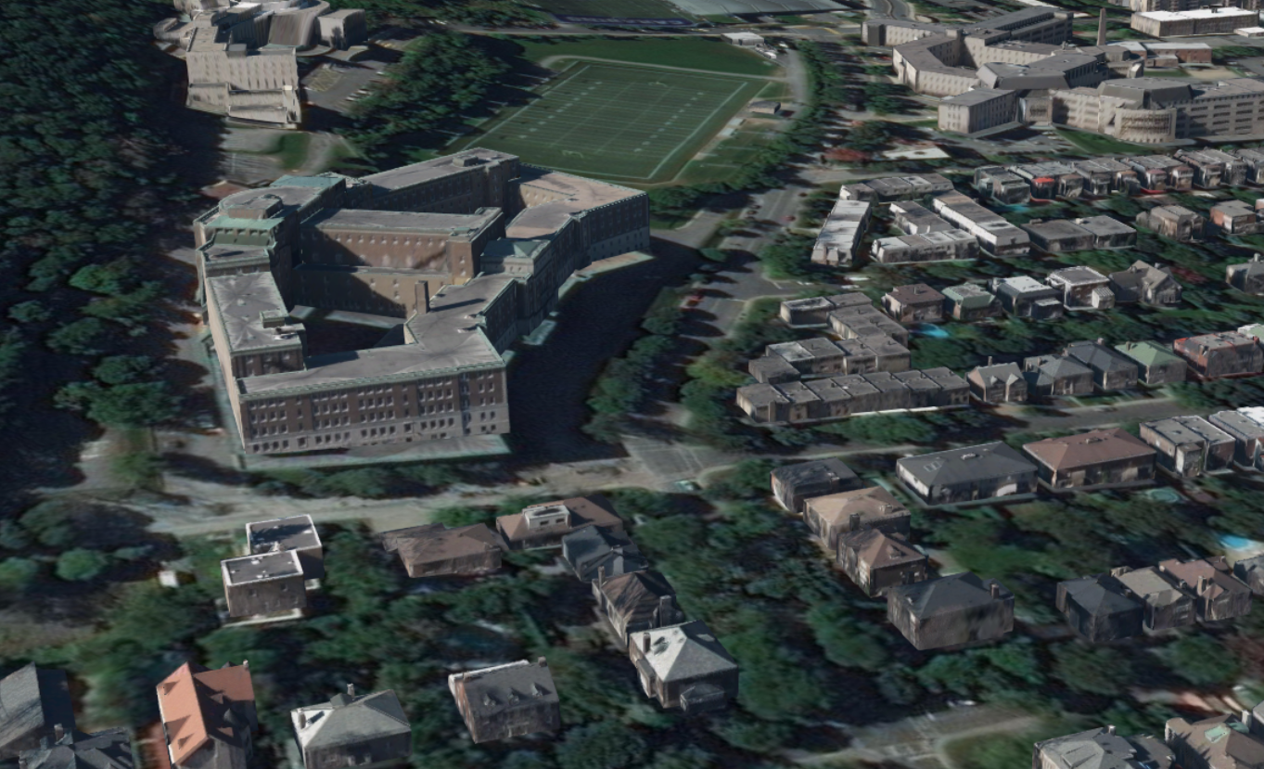
Content
We would like to identify these possibilities, and to propose options for the boundary of an alternate resource, perhaps showing some examples from our own server and from other participants. We would also look to create conceptual diagrams to visualize the different options.
Following this, we would provide insight into the implications of these options by devising a set of use-cases, and considering the outcomes for each, before providing recommendations on option(s) for future consideration.
We will also consider whether there would be issues with how this will be implemented in OpenAPI
… Stretch goal of Challenge 3

Slide 4
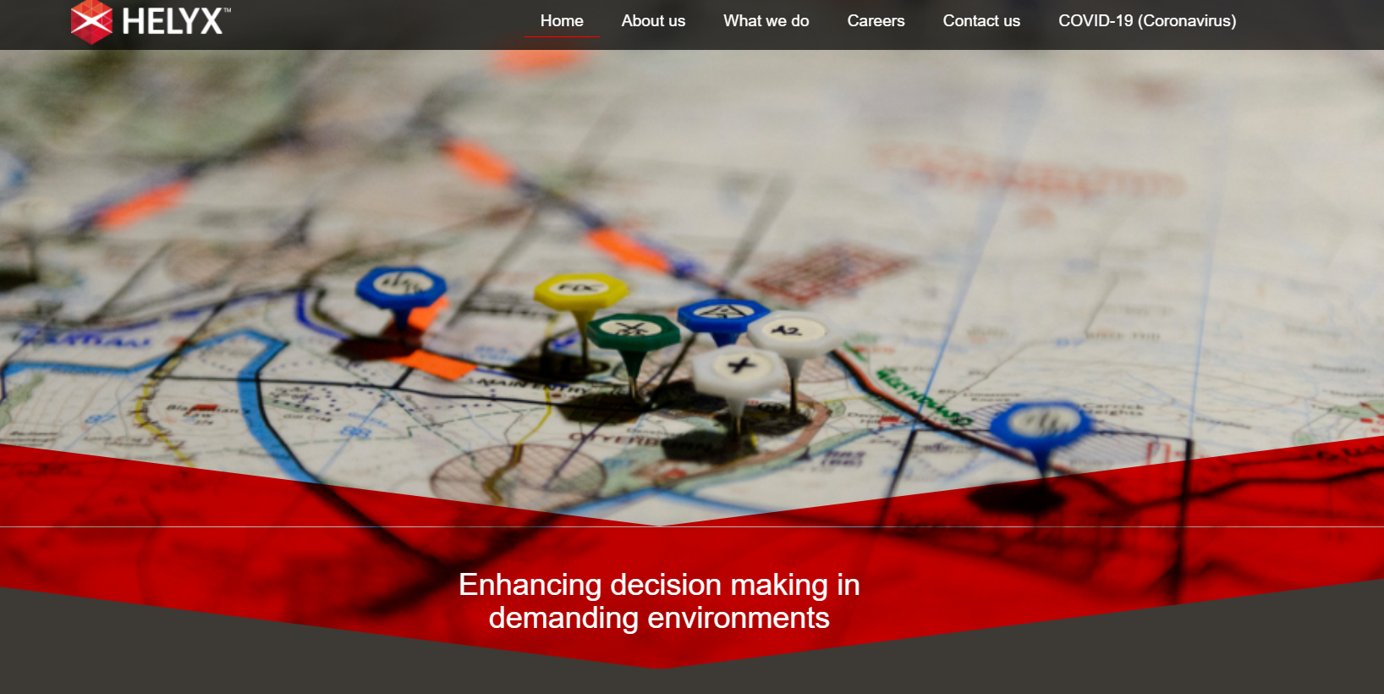
last slide (10 seconds)
For further information about Helyx, visit the following links:
www.helyx.co.uk
3d pilot server: http://helyxapache2.eastus.azurecontainer.io/

Slide 5
The end.

